Slide 1

CHILD VACCINATION MANAGEMENT SYSTEM
LAKSHMI H
MES24MCA-2027
Department of Computer Applications
MES College of Engineering, Kuttippuram
20-08-2025

Slide 2
PRODUCT OWNER Ms.PRIYA J D ASSISTANT PROFESSOR DEPARTMENT OF COMPUTER APPLICATIONS MES COLLEGE OF ENGINEERING, KUTTIPPURAM

Slide 3
TABLE OF CONTENTS
Introduction
Objective
Existing System
Proposed System
Motivation
Functionalities
Module Description
Developing Environment
Sprint Backlog
Product Backlog
User Story
Project Plans
Data Flow Diagrams
ER Diagram

Slide 4
CHILD VACCINATION MANAGEMENT SYSTEM
A web based application that automates and simplifies child vaccination management.
Provides parents with features to register children, book appointments, and get reminders.
Allows hospitals to manage appointments and vaccination records.
Enables admins to oversee the system, approve hospitals, and generate vaccination reports.

Slide 5
OBJECTIVES
To digitize and centralize vaccination records of children for easy access and management.
To enable parents to book vaccination appointments and receive timely reminders for upcoming vaccines.
To assist hospitals in managing appointments and updating vaccination status efficiently.
To support administrators in monitoring vaccination data and generating reports for healthcare planning.

Slide 6
EXISTING SYSTEM
Paper-based or Excel records prone to loss and errors.
Parents rely on physical vaccination cards and memory for schedules.
No automated reminders — high chance of missed doses.
Appointment booking requires physical visits or calls.
No centralized tracking or historical data access.

Slide 7
PROPOSED SYSTEM
Centralized digital database for secure and accurate records.
Online registration, login, and appointment booking for parents.
Automated reminders via email/SMS/dashboard.
Hospital dashboards for managing appointments and updating statuses.
Admin panel for hospital approval, monitoring, and report generation.

Slide 8
MOTIVATIONS
Many parents miss vaccination dates due to lack of reminders and proper scheduling systems.
Existing systems are often manual or paper based, leading to errors, data loss and inefficiency.
There is a need for a centralized platform that connects parents ,hospitals and administrators for better healthcare delivery.
A digital solution can improve child healthcare outcomes by ensuring timely vaccinations and accurate record-keeping.

Slide 9
FUNCTIONALITIES
Admin Module:
Manage hospitals, view all appointments and child data, export vaccination reports.
Hospital Module:
Register and log in after admin approval, view appointments by date, update vaccination status.
Parent Module:
Register and manage their child’s profile, book appointments, view vaccination reminders and history, search for nearby hospitals.
Other Features:
Automated appointment reminders (email/SMS), login authentication, role-based access.

Slide 10
MODULE DESCRIPTION
Parent Module:
Enables parents to register/login, manage profiles and child details, book appointments, view vaccination status, and receive reminders via dashboard, email, or SMS.
Hospital Module:
Allows hospitals to register (with admin approval), manage appointments, update vaccination status, and maintain hospital profiles.
Admin Module:
Provides admin with tools to log in, approve/reject hospital registrations, monitor parent/child data, track appointments, and export reports.

Slide 11
DEVELOPING ENVIRONMENT
Operating System: Windows 10 or higher
Frontend: HTML5, CSS3, JavaScript (Bootstrap)
Backend: Python (Django Framework)
Database: MySQL / SQLite
IDE: Visual Studio Code / Sublime Text
Other Tools: XAMPP, Django REST Framework (optional), Git for version control

Slide 12
SPRINT PLAN
Backlog tem | Completion Date | Original Estimation in Hours | Day 1 hrs | Day 2 hrs | Day 3 hrs | Day 4 hrs | Day 5 hrs | Day 6 hrs | Day 7 hrs | Day 8 hrs | Day 9 hrs | Day 10 hrs
SPRINT1
Implement parent registration/login | 9/9/2025 | 12 | 0 | 0 | 4 | 4 | 3 | 1 | 0 | 0 | 0 | 0
SPRINT 2
Create Child model and forms | 23/9/2025 | 6 | 0 | 0 | 0 | 3 | 3 | 0 | 0 | 0 | 0 | 0
Edit/Delete child details | 02/9/2025 | 6 | 0 | 0 | 0 | 0 | 2 | 3 | 1 | 0 | 0 | 0

Slide 13
SPRINT PLAN
Backlog tem | Completion Date | Original Estimation in Hours | Day 1 hrs | Day 2 hrs | Day 3 hrs | Day 4 hrs | Day 5 hrs | Day 6 hrs | Day 7 hrs | Day 8 hrs | Day 9 hrs | Day 10 hrs
SPRINT3
Hospital registration & approval system | 16/09/2025 | 12 | 0 | 0 | 0 | 0 | 1 | 3 | 4 | 4 | 0 | 0
SPRINT 4
Appointment booking system | 20/09/2025 | 6 | 0 | 0 | 0 | 0 | 0 | 1 | 2 | 3 | 0 | 0
Email/SMS reminder system | 30/09/2025 | 6 | 0 | 0 | 0 | 0 | 0 | 0 | 0 | 3 | 2 | 1

Slide 14
SPRINT PLAN
Backlog tem | Completion Date | Original Estimation in Hours | Day 1 hrs | Day 2 hrs | Day 3 hrs | Day 4 hrs | Day 5 hrs | Day 6 hrs | Day 7 hrs | Day 8 hrs | Day 9 hrs | Day 10 hrs
SPRINT5
Testing and bug fixing | 08/10/2025 | 12 | 0 | 0 | 0 | 0 | 0 | 0 | 2 | 4 | 3 | 3
TOTAL |  | 60 | 2 | 5 | 5 | 3 | 6 | 7 | 9 | 14 | 5 | 4

Slide 15
PRODUCT BACKLOG
ID | NAME | PRIORITY <high/medium/low> | ESTIMATE (Hours) | STATUS <Planned/In progress/Completed>
1 | SET UP DJANGO PROJECT & APP STRUCTURE | High | 4 | IN PROGRESS
2 | CONFIGURE DATABASE (MySQL/SQLite) | High | 4 | PLANNED
3 | IMPLEMENT PARENT REGISTRATION/LOGIN | High | 4 | PLANNED

Slide 16
PRODUCT BACKLOG
ID | NAME | PRIORITY <high/medium/low> | ESTIMATE (Hours) | STATUS <Planned/In progress/Completed>
4 | CREATE CHILD MODEL AND FORMS | High | 6 | PLANNED
5 | EDIT/DELETE CHILD DETAILS | MEDIUM | 6 | PLANNED
6 | HOSPITAL REGISTRATION & APPROVAL SYSTEM | High | 12 | PLANNED
7 | APPOINTMENT BOOKING SYSTEM | High | 6 | PLANNED

Slide 17
PRODUCT BACKLOG
ID | NAME | PRIORITY <high/medium/low> | ESTIMATE (Hours) | STATUS <Planned/In progress/Completed>
8 | EMAIL/SMS REMINDER SYSTEM | MEDIUM | 6 | PLANNED
9 | TESTING AND BUG FIXING | HIGH | 6 | PLANNED
10 | EXPORT DATA(CSV/PDF) | LOW | 6 | PLANNED

Slide 18
USER STORY
User Story ID | As a type of User | I want to <Perform some task> | So that i can <Achieve Some Goal>
1 | ADMIN | Login | Manage the system
2 | ADMIN | View and Manage | Approve or reject them and can oversee the vaccination process.
3 | ADMIN | Export | Maintain official records.
4 | ADMIN | Monitor | Ensure smooth operations.
5 | PARENT | Register and Login | securely access my child’s vaccination records.
6 | PARENT | Add | Keep track of their vaccination history.

Slide 19
USER STORY
User Story ID | As a type of User | I want to <Perform some task> | So that i can <Achieve Some Goal>
7 | PARENT | Update or Delete | Ensure the information is accurate.
8 | PARENT | Search | Book vaccinations conveniently.
9 | PARENT | Book | Ensure my child gets vaccinated on time.
10 | PARENT | View | Track completed and pending vaccines.
11 | PARENT | Recieve | Not miss any scheduled vaccination dates.

Slide 20
USER STORY
User Story ID | As a type of User | I want to <Perform some task> | So that i can <Achieve Some Goal>
12 | HOSPITAL | Register | Offer vaccination services.
13 | HOSPITAL | Manage | Start managing appointments.
14 | HOSPITAL | View | Prepare for scheduled vaccinations.
15 | HOSPITAL | Update | Parents know if the vaccine was administered.
16 | HOSPITAL | Filter | Plan my daily schedule effectively.

Slide 21
PROJECT PLAN
User StoryID | Task Name | Start Date | End Date | Days | Status
1 | SPRINT 1 | 06/08/2025 | 09/08/2025 | 14 | In Progress
2 |  | 10/08/2025 | 12/08/2025 |  | In Progress
3 |  | 13/08/2025 | 15/08/2025 |  | In Progress
4 |  | 16/08/2025 | 19/08/2025 |  | In Progress
5 | SPRINT 2 | 20/08/2025 | 23/08/2025 | 14 | Planned
6 |  | 24/08/2025 | 26/08/2025 |  | Planned
7 |  | 27/08/2025 | 02/09/2025 |  | Planned

Slide 22
PROJECT PLAN
User StoryID | Task Name | Start Date | End Date | Days | Status
8 | SPRINT 3 | 03/09/2025 | 06/09/2025 | 14 | Planned
9 |  | 07/09/2025 | 09/09/2025 |  | Planned
10 |  | 10/09/2025 | 16/09/2025 |  | Planned
11 | SPRINT 4 | 17/09/2025 | 20/09/2025 | 14 | Planned
12 |  | 21/09/2025 | 23/09/2025 |  | Planned
13 |  | 24/09/2025 | 30/09/2025 |  | Planned
14 | SPRINT 5 | 01/10/2025 | 03/10/2025 | 9 | Planned
15 |  | 04/10/2025 | 06/10/2025 |  | Planned
16 |  | 07/10/2025 | 09/10/2025 |  | Planned

Slide 23
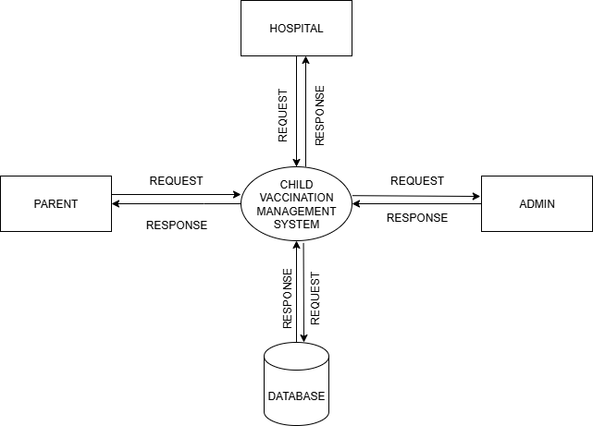
DATA FLOW DIAGRAM
LEVEL 0

Slide 24
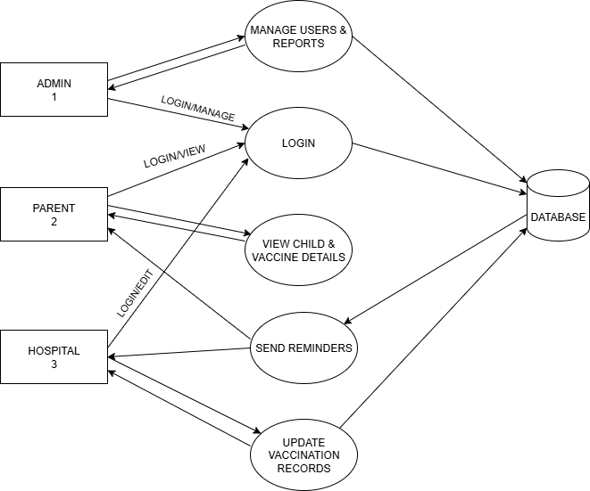
DATA FLOW DIAGRAM
Level 1

Slide 25
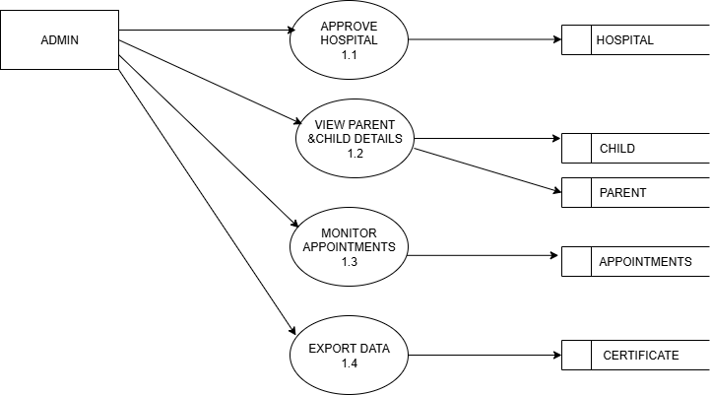
DATA FLOW DIAGRAM
Level 1.1

Slide 26
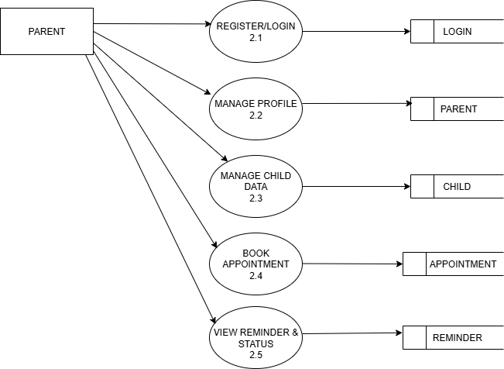
DATA FLOW DIAGRAM
Level 1.2

Slide 27
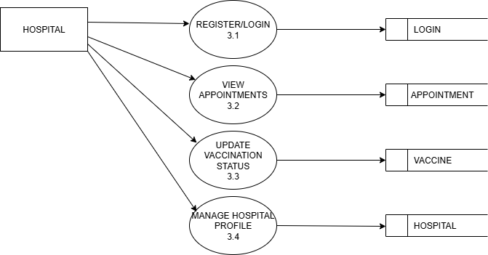
DATA FLOW DIAGRAM
Level 1.3

Slide 28
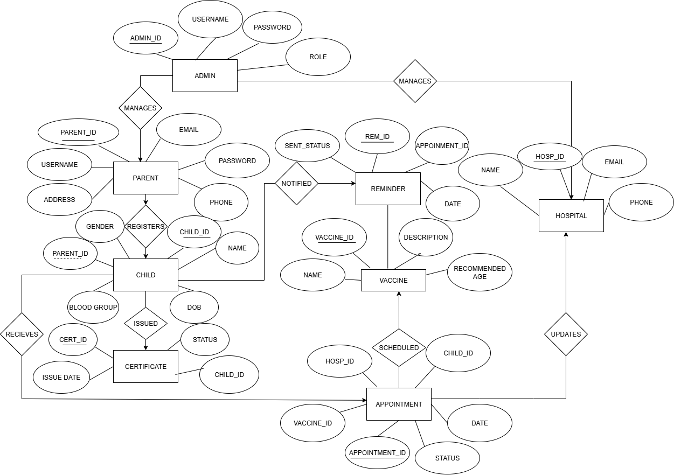
ER DIAGRAM

Slide 29
THANK YOU

